Slide 1
What is Domestic Violence?
In the US and more than 80 countries, domestic violence is a crime. It is defined as a pattern of abusive tactics perpetrated by a spouse, partner or significant other, with the goal of establishing or maintaining power and control over the victim.

Slide 2
Statistics
The United States Center for Disease Control and Prevention reports 1200
deaths and 2 million injuries to women from intimate partner violence
each year in the U.S. on average, 3 women are murdered by their
husbands or boyfriends each day in this country. 15.5 million U.S. children
live in families in which partner violence occurred at least once in the
past year, and7 million children live in families in which severe partner
violence occurred.

Slide 3
Statistics
♦One in every four women will experience domestic abuse in her life time.
♦85% of domestic victims are women.
♦Historically, females have most often victimized by someone they knew.
♦Females who are 20-24 years of age are at the greatest risk of nonfatal intimate partner abuse.

Slide 4
Statistics
♦Most cases of domestic abuse are never reported to the police.
♦ Those who experience dating violence are more likely to participate in binge drinking, fighting, and /or smoking, and are at an increased risk of suffering from mental illness.
♦Witnessing violence between one’s parents or caretakers is the strongest risk factor of transmitting violent behavior from one generation to the next.

Slide 5
Statistics
About 1 in 4 women and 1 in 10 men have experienced contact sexual violence, physical violence, or stalking by an intimate partner during their lifetime and reported at least one impact of the violence (like being concerned for their safety).
Over 43 million women and about 38 million men experienced psychological aggression by an intimate partner in their lifetime
See more data from CDC’s National Intimate Partner and Sexual Violence Survey (NISVS)

Slide 6
Statistics Domestic Violence and the LGBTQ Community
43.8% of lesbian women and 61.1% of bisexual women have experienced rape, physical violence, and/or stalking by an intimate partner at some point in their lifetime, as opposed to 35% of heterosexual women.
26% of gay men and 37.3% of bisexual men have experienced rape, physical violence, and/or stalking by an intimate partner in their lifetime, in comparison to 29% of heterosexual men.

Slide 7
.
In a study of male same sex relationships, only 26% of men called the police for assistance after experiencing near-lethal violence.
In 2012, fewer than 5% of LGBTQ survivors of intimate partner violence sought orders of protection.
Transgender victims are more likely to experience intimate partner violence in public, compared to those who do not identify as transgender.
Bisexual victims are more likely to experience sexual violence, compared to people who do not identify as bisexual.

Slide 8
.
LGBTQ Black/African American victims are more likely to experience physical intimate partner violence, compared to those who do not identify as Black/African American.
LGBTQ white victims are more likely to experience sexual violence, compared to those who do not identify as white.
LGBTQ victims on public assistance are more likely to experience intimate partner violence compared to those who are not on public assistance.

Slide 9
Forms of Domestic Violence
Domestic violence takes many forms and can happen occasionally or continuously. It often gets worse over time.

Slide 10
Forms of Domestic Violence
♦Psychological and Emotional Abuse
The victim is told that they are ugly, fat, hopeless, stupid, a bad parent, ect.
Forms of this kind of abuse include stalking, intimidation or emotional blackmail with statements like…”If you really love me, you would…”
♦Social Abuse
The victim is not allowed to see the people they want to see, or doesn’t see family or friends because it isn’t worth all the argument
♦Financial Abuse
The victim is not given enough money to feed and clothe themself or the children and/or receives no money for paying bills but is expected to make ends meet. The victim may also be forced to hand over their money or is prevented by their perpetrator from getting or keeping a job.

Slide 11
Forms of Domestic Violence
Physical Abuse
The victim is pushed, shoved, slapped, hit, punched or kicked, or objects are used as weapons against her. This is the most obvious form of domestic violence.
Sexual Abuse
  The victim is pressured or forced to participate in sexual activities against their will.
  Although both women and men can be victims, for ease of communication, the text throughout this guide uses ”she” in many instances. This does not indicate that abuse is limited to women.

Slide 12
Five types of IPV,(Interpersonal Violence)
Sexual violence includes rape, being made to penetrate someone else, sexual coercion, unwanted sexual contact, and non-contact unwanted sexual experiences. Contact sexual violence (SV) is a combined measure that includes rape, being made to penetrate someone else, sexual coercion, and/or unwanted sexual contact.
Stalking victimization involves a pattern of harassing or threatening tactics used by a perpetrator that is both unwanted and causes fear or safety concerns in the victim.

Slide 13
.
Physical violence includes a range of behaviors from slapping, pushing or shoving to severe acts that include hit with a fist or something hard, kicked, hurt by pulling hair, slammed against something, tried to hurt by choking or suffocating, beaten, burned on purpose, used a knife or gun.
Psychological aggression includes expressive aggression (such as name calling, insulting or humiliating an intimate partner) and coercive control, which includes behaviors that are intended to monitor and control or threaten an intimate partner.
Control of reproductive or sexual health includes the refusal by an intimate partner to use a condom. For a woman, it also includes times when a partner tried to get her pregnant when she did not want to become pregnant. For a man, it also includes times when a partner tried to get pregnant when the man did not want her to become pregnant.
.

Slide 14
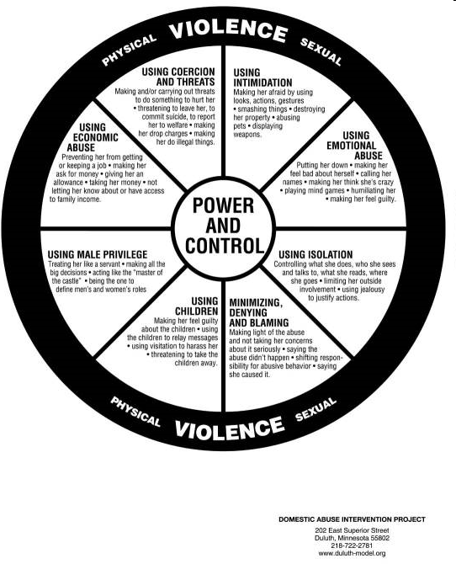

Slide 15
Why Does The Victim Stay?
The reasons for staying in an abusive relationship are complex. Often there are many aspects to the relationship that do not allow the victim to leave. Most often, she is afraid and fears for the safety of herself and her children. Some reasons victims don’t leave include:
She fears she will lose custody of her children, or she fears the abuser will cause emotional or physical harm to her children if she tries to leave.
She may have limited financial resources or lack access to alternative support or skills to secure work.
Religious beliefs may stand in the way; a religious community may not support a victim who leaves or seeks divorce.
Friends and family may not support her leaving. The abuser may have convinced friends and family that their relationship is good and that any problems are the victim’s fault or “in her head”.

Slide 16
Why does the Victim Stay (cont.)
She may have grown up with violence and may consider an abusive relationship “normal”.
She may not want the relationship to end-she still loves her spouse or partner and just wants the violence to stop. She may believe that love can change the abusive behavior.
She may not know who to turn to for help or where to get assistance.
She may feel shame about being abused and reluctant to let anyone know that abuse is occurring in the relationship.
There may be language barriers that prevent her from seeking help or independence, or she may fear deportation.

Slide 17
Domestic Abuse Later in Life
Abuse in later life comprises financial, physical, sexual, and emotional abuse, abandonment and neglect.1 Perpetrators are people with whom the victim has an expectation of trust, particularly spouses, intimate partners, adult children, grandchildren, other family members, and non-related caregivers.2 Perpetrators typically, but not exclusively, abuse older adults in their places of residence.

Slide 18
TYPES OF ELDER ABUSE
EMOTIONAL ABUSE INCLUDES - Embarrassment and humiliation - Controlling behavior (restricting access to telephone, transportation, and other resources) - Damaging or destroying property - Social isolation - Disregarding or trivializing needs
PHYSICAL ABUSE Physical abuse of an elder involves injury, assault, or inappropriate restraint.17 Indicators include: - Broken bones, fractures, sprains, and/or dislocations - Burns from cigarettes, hot water, or appliances - Abrasions on arms, legs, or torso resembling rope or restraints - Bruises, including bilateral and “wrap around” bruises - Unexplained injuries or explanations that do not “fit” - History of similar injuries and numerous or suspicious hospital visits - Delay between onset of injury and seeking medical attention - Neglect of bedridden adults’ injuries

Slide 19
.
SEXUAL ABUSE Elder sexual abuse is any non-consensual sexual contact: - Non-consensual oral, anal or vaginal intercourse - Forced viewing of pornography20 - Forced listening of sexual accounts - Intentional touching of the genitalia, anus, groin, breast, mouth, inner thigh, or buttocks
FINANCIAL ABUSE Financial abuse includes, but is not limited to: - Fraud - Forced property transfers23 - Misuse or theft of money/possessions24 - Use of deception to coerce or convince a victim to surrender finances or property

Slide 20
Planning for safety
Studies show that domestic violence homicides increase up to 75% when a victim tries to leave or end an abusive relationship. Domestic violence homicides often happen after leaving an abuser, so leaving doesn’t always mean safety.
If someone is planning to leave an abusive relationship or to take any legal or financial steps to separate, safety planning in advance is critical!
The victim should follow these steps as necessary:
♦Call 911 or arrange a signal with a neighbor or a friend to call 911 if there is immediate danger.
♦Call a local DV program 1-800-924-2624 or the national DV Hotline 1-800-799-SAFE for help, advice and support.
♦Hide money, spare keys and a small bag of clothes and other necessities for herself and her children at work or at a friend’s house.

Slide 21
Safety Plan Con’t
♦Put together important documents (or copies ) including passports, birth certificates, social security cards, insurance papers, work permits or green cards, ownership( title) documents for car and/or house, checkbooks and bank account numbers for herself and her children. Hide these papers at work or with a friend. Know the abuser’s social security number, birth date and place of birth.
♦Document the abuse by taking photos of bruises and injuries. Tell the doctor and get copies of medical records. Save any threatening voicemails or e-mails and write each incident down in a journal. All this is extremely important if legal action is taken in the future.
♦Obtain an order of protection from the court which prohibits the abuser from contacting, attacking, sexually assaulting or telephoning her, her children and other family members. Call Family Advocates Inc. or the National DV hotline for legal assistance.

Slide 22
Family Advocates Provides Services to Domestic Violence Victims/Survivors
Emergency Shelter
24 Hour Crisis Line + On Call Services
Advocacy/Peer Counseling
Legal Advocacy
Law Enforcement/Court Advocacy
Information and Referral
Support Groups
Prevention, Intervention, & Education
Not mandated reporters
All services are free and confidential

